Slide 1

What Types of Evidence Do We Need to Produce Relevant and Sustainable Interventions??
Russell E. Glasgow, PhD
Deputy Director, Implementation Science Division of Cancer Control & Population Sciences
National Cancer Institute
ASPO, MARCH 2012
Georgetown

Slide 2
NCI Implementation Science Team Mission
The mission of the Implementation Science (IS) Team is to build and advance the field of Implementation Science by:
Promoting science that is rigorous, transparent and relevant in the real world;
Fostering rapid learning strategies for improving individual and population health; and
Building partnerships for the development, dissemination and implementation of evidence-based measures, initiatives and programs.
http://cancercontrol-dev.cancer.gov/IS/index.html
2

Slide 3
Evidence Needed: 2R’s and ‘RCCT’
Relevant
Rigorous
Rapid
Cost
Convergent
Transparent
Relevant
Rigorous and
Rapid
Cost
Convergent
Transparent
3
Glasgow R, Annals of Behavioral Medicine, 2008, 35: 19-25.
Glasgow R, Chambers D. Clinical and Translational Science, in press, 2012

Slide 4
Relevant (Contextual and Practical)
Relevant
Rigorous
Rapid
Cost
Convergent
Transparent
Relevant to stakeholders (patients/family, clinicians, administrators, policy makers)
Relevant samples- representative of real world, including patients with co-morbid conditions
Relevant settings- similar to those in practice (not just the most advanced and well resourced)
Relevant clinicians- including those who have other duties and competing demands
4

Slide 5
RE-AIM Implications: Transparent Reporting
Relevant
Rigorous
Rapid
Cost
Convergent
Transparent
CONSORT Pragmatic Trials Reporting Criteria^{1, 2}
Real-world stakeholder questions
Multiple outcomes…of interest to stakeholders— costs and Return on Investment
Real-world comparison conditions- consider “Minimal Intervention Needed for Change” (MINC)
Multiple settings—replications
CONSORT “PLUS” flow diagram³
¹Glasgow RE, et al. Health Services Research, 2011, Nov 2. doi: 10.1111/j.1475-6773.2011.01347.x.
²Zwarenstein M, et al. Br Med J 2008;(11 November) 337:a2390
³ http://cancercontrol.cancer.gov/IS/reaim/figures-and-tables.html
5

Slide 6
Rigorous…. and a word about RCTs
Relevant
Rigorous
Rapid
Cost
Convergent
Transparent
Address most likely challenges to validity and conclusions for THAT question
Both external and internal validity are important
Design should fit the question- NOT vice-versa¹
An RCT is not an RCT is not an RCT
CONSORT delineation of Pragmatic trials is an important advance²
RCT is not the only design that is experimental- and it does NOT guarantee causality ^{3,4,5}
¹ Mercer S et al. Amer J Prev Med, 2007; 3:, 139-154.
² Thorpe et al. J Clin Epidem 2009; 62: 464–475, Can Med Ass J 2009; 180, E47-E57.
³ Kessler & Glasgow, Amer J Prev Med, 2011, 40, 637-644;
⁴ Cartwright BioSocieties, 2007, 2: 11-20.
⁵ Grossman J, MacKenzie FJ. Persp Biol & Med 2005, 48: 516-534.
6
Notes:
Add other refs sent for this slide

Slide 7
Rigorous Designs
Relevant
Rigorous
Rapid
Cost
Convergent
Transparent
Multiple Baseline Across Settings
Interrupted Time Series (with replication)
RCT- individual, cluster randomized, mTCT
N of 1
Regression-discontinuity
Cross-over
Prospective Meta-analyses
Comparative Case Study
Natural experiments- with replication and addressing contextual factors
Preference
Many hybrid and quasi-experimental designs
7

Slide 8
Rapid Evidence
Relevant
Rigorous
Rapid
Cost
Convergent
Transparent
Need rapid learning research- especially for pressing issues such as obesity, HIV, explosion of health care spending, health inequities
EMR, and their potential enhancements, make possible ‘rapid learning health care systems’*
Real time data on millions of real world patients in real world health care settings, treated under usual conditions
Institute of Medicine, A Foundation for Evidence-Driven Practice: A Rapid Learning System for Cancer Care, 2010. http://www.iom.edu/Reports/2010/A-Foundation-for-Evidence-Driven-Practice-A-Rapid-Learning-System-for-Cancer-Care.aspx
Etheredge L et al, Health Affairs, Web Exclusive Collection, w107-w118, doi:10.1377/hlthaff.26.2.w107)
Glasgow R, Chambers D. Clinical Translational Science, 2012, in press
8

Slide 9
How to Evaluate Technologies that Outpace Research?
Relevant
Rigorous
Rapid
Cost
Convergent
Transparent
YouTube
iPhone
Android
iPad
2005
2006
2007
2008
2009
2010
2011
Grant Submit and Award
Development and Pilot Testing
Recruit and Randomize
Follow-ups
Analyze and Publish
William Riley, NHLBI

Slide 10
Cost Evidence
Relevant
Rigorous
Rapid
Cost
Convergent
Transparent
Replication costs and scalability costs are arguably most needed
Perspective- patient and adopting setting
Costs should be comprehensive and transparent
‘One persons costs are another’s profits’
Cost-effectiveness analyses need not be overwhelming¹- cost per incremental unit change
Should be harmonized and include costs frequently not counted that need to be- e.g., recruitment, overhead, training, preparation and supervision¹
10
¹ Ritzwoller et al, Trans Behav Med, 2011, 1, 427-435.

Slide 11
Public Health Cost Questions to Ask….
Relevant
Rigorous
Rapid
Cost
Convergent
Transparent
In this world of “the 4 P’s” of personalized medicine…. ALSO ask the 4 “W’s”:
Who Benefits
Who Suffers
Who Pays
Who Profits
11
Glasgow RE, Fisher EB, Haire-Joshu D, Goldstein MG. NIH Science Agenda: A Public Health Perspective. Am J Public Health 97(11):1936-1938
Notes:
Change headers….

Slide 12
Convergent Evidence
Relevant
Rigorous
Rapid
Cost
Convergent
Transparent
Much to learn from well conducted observational studies
Huge amount of potential for simulation modeling- esp. re: interactions and unintended consequences^{1,2}
Evaluability³- aka initial ‘sniff test’
Mixed methods⁴ and qualitative
Practice-based evidence on efficiency and feasibility
Emphasis on replication and consistency
Combine with experimental
¹ Stern M, Williams K, Eddy D, Kahn R.Diabetes Care. 2008 Aug;31(8):1670-1.
² Mabry, P .Am J Prev Med. 2011 May; 40 (5 Suppl 2):S159-61
³ Leviton, L. Ann Rev Public Health, 2010, 3:, 213-233.
⁴ Creswell J, Klassen A, Plano-Clark V, Smith, LC. 2011, NIH-OBSSR. Mixed Methods Summary: http://obssr.od.nih.gov/scientific_areas/methodology/mixed_methods_research/pdf/Best_Practices_for_Mixed_Methods_Research.pdf
12

Slide 13
Transparent Evidence on…..
Relevant
Rigorous
Rapid
Cost
Convergent
Transparent
Info needed to replicate or implement
Resources required- costs for patients and delivery setting perspectives
How were settings, clinicians, and patients selected- (who was excluded and why)
Adaptation- changes made to protocol, to intervention, to recruitment, etc.
Differences across settings
13

Slide 14
The Pragmatic-Explanatory Continuum Indicator Summary (PRECIS)
Relevant
Rigorous
Rapid
Cost
Convergent
Transparent
Describes ten domains that affect the degree to which a trial is pragmatic or explanatory.
1. Participant eligibility criteria
2. Experimental intervention flexibility
3. Practitioner expertise (experimental)
4. Comparison intervention
5. Practitioner expertise (comparison) outcome
6. Follow-up intensity
7. Primary trial outcome
8. Participant compliance
Practitioner adherence
Analysis of primary outcome
14
Thorpe KE, et al. J Clin Epidemiol 2009; 62: 464–475, Can Med Assoc J 2009; 180(10)
Notes:
Here are the 10 criteria or dimensions that they have identified along which trials vary
14

Slide 15
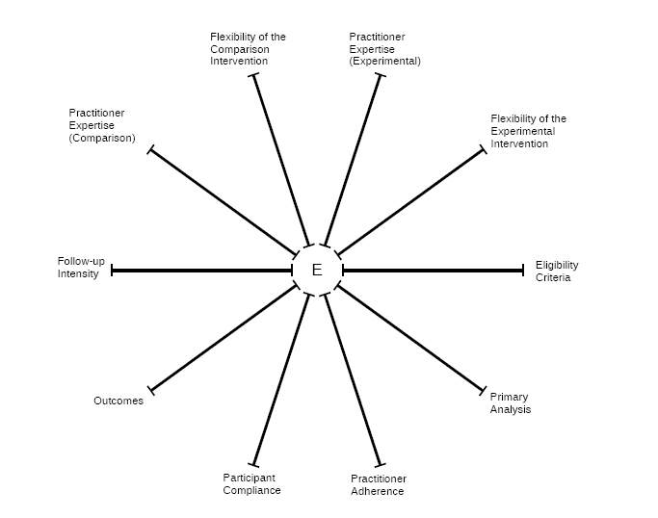
15
Notes:
And here is the rather clever summary figure that they have developed to visually show this in a glance.
I is a Spoke and Wheel diagram with a centroid and 10 ‘spokes going out toward the extreme. For each of the 10 dimensions we just discussed, a given study/intervention is rated along a 0-4 scale with 4 being more pragmatic…
One places a point on each of the 10 spokes an dthen ‘connects the dots…..So- next figure…..
15

Slide 16
PRAGMATIC STUDY
EXPLANATORY STUDY
16
Notes:
As you can see here- a) a pragmatic study will have a figure that is larger such as that on the left……. b) an explanatory study would be illustrated as much smaller and closer to the centroid- as shown in the figure on he right.
The other thing is that one can quickly see particular dimensions on which a study is more vs. less pragmatic… and in that sense these figures are a bit of straw men in that almost all dimensions are either consistently pragmatic or consistently explanatory. Later we will see a real world example that the scores across PRECIS dimensions are more variable

Slide 17
Future Evidence Needs- Keys to Advance Translation
Relevant
Rigorous
Rapid
Cost
Convergent
Transparent
Context- key factors that may be moderators
Scalability
Sustainability
Health inequities impacts
Patient/citizen/consumer and community perspective
Multi-level interactions, especially between policy and practice
17

Slide 18
Evidence Integration Triangle (EIT)
Intervention Program/Policy (Prevention or Treatment)
(e.g., key components; principles; guidebook; internal & external validity)
Feedback
Evidence
Feedback
Stakeholders
Participatory Implementation Process
(e.g., stakeholder engagement; CBPR; team-based science; patient centered)
Feedback
Practical Progress Measures
(e.g., actionable & longitudinal measures)
Multi-Level Context
Intrapersonal/Biological | Policy
Interpersonal/Family | Community/Economic
Organizational | Social/Environment/History
18
Glasgow, R, Green, Taylor, Stange, Am J Prev Med, in press

Slide 19
EIT Conclusions
Relevant
Rigorous
Rapid
Cost
Convergent
Transparent
The evidence-based movement is a good start, but only gets us so far
To make greater progress, two other elements also need attention:
Practical MEASURES to track progress, and
Implementation PROCESSES that use partnership principles
These 3 legs of the ‘EIT” are each necessary but not sufficient by themselves
19
http://cancercontrol-dev.cancer.gov/IS/presentations/
Notes:
Change headers

Slide 20
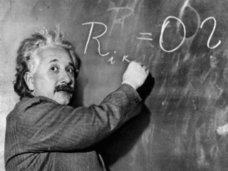
The same research methods, policies, paradigms and approaches that produced today’s inequities are not likely to reduce them
“The significant problems we face cannot be solved by the same level of thinking that created them.”
A. Einstein
20

Slide 21

Questions? Comments?
I am all ears
glasgowre@mail.nih.gov
NCI Implementation Science Website: http://cancercontrol.cancer.gov/IS/
21

